Slide 1
Driving under the Influence of Language
Under the guidance of
Prof. Naina Kaushik
Group Members:
Dhruv Solanki ( B- 841)
Mohit Tiwari (B- 850)
Aditya Vartak (B –852)
Saurabh Wanivadekar(B-855)

Slide 2
Abstract
Language control enables the robot to move in unexplored environments
Autonomous Self-Driving Robot which is to be used in Emergency situations of Fire Breakouts. which has 3 phases –
Acquisition phase: where the word-meanings are learned from natural language sentences.
Generation Phase: robot is moved in the environment manually so that the robot generates sentential descriptions for its motion .
Comprehension phase: Where the robot infers from the input natural language sentence and generates a sequence of waypoints to navigate the environment.
We design a robot who can extinguish fire based on human commands and thus serve as a companion to the Fire-Fighters in their operations.

Slide 3
Introduction
Autonomous Robots perform tasks on its own without Human assistance
Language control is the field of Artificial Intelligence where Natural Language of humans can be understood by the machines to perform desired tasks
We integrate Language control in our Robot to make the Robot Intelligent enough to understand the Human Language for achieving navigation goals.

Slide 4
Problem Statement
To generate a framework for Robot Navigation using Natural Language Sentences with a need for the development and use of framework for specific applications to yield better results in the domain it is trained to work on.

Slide 5
Proposed System
Building a system which is capable of processing Natural Language statement into sequence of waypoints for the robot in the given environment.
The system will also be able to detect fire in the environment based on natural language statements and extinguish it.
Input to system are Natural Language statement and floorplan.The output of the system would be sequence of waypoints to generate path of robot motion in environment.

Slide 6
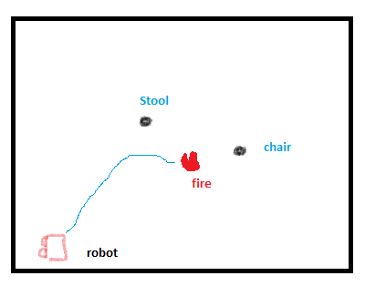
Proposed System (Contd.)
Fig 1: Robot Path for the input sentence “The Robot went towards the stool, then went to the fire which is left of the chair”. Black Dots represent objects in the environment and blue line represents robotic path.

Slide 7
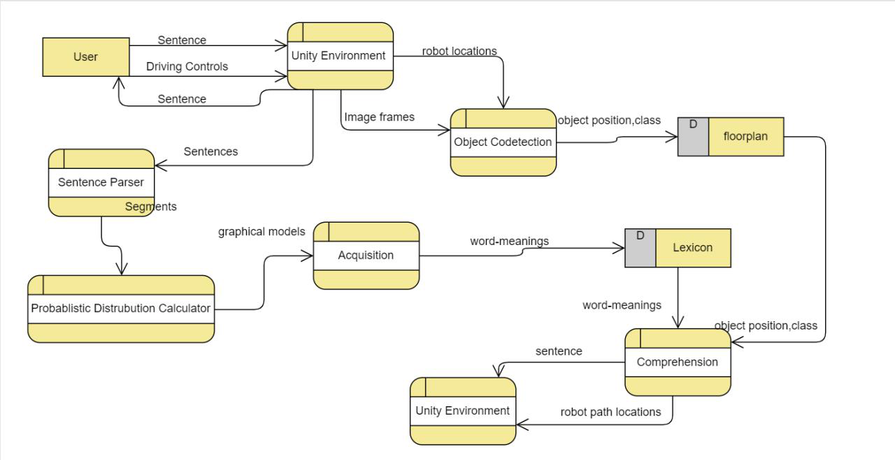
Software Architecture
Fig.5 Data Flow Architecture of the system

Slide 8
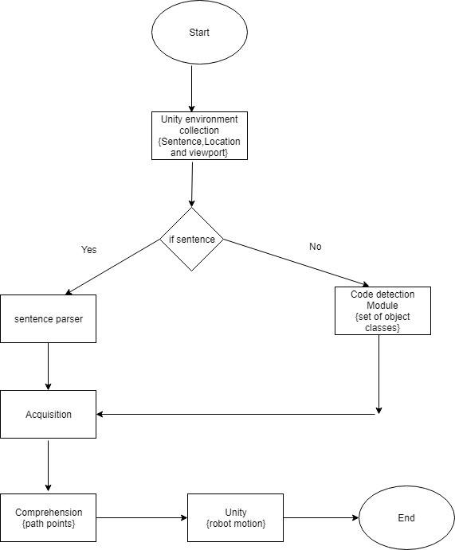
Project Flow

Slide 9
Implementation Plan
Our project will be implemented in two parts
A)Environment Simulation: using Unity3D to create simulation of environment
B)AI of robot: The brain of the robot. It would:
Detect classes of objects in environment
Learn word meanings in Acquisition
Use the Learned Meanings for generating robot path in environment

Slide 10
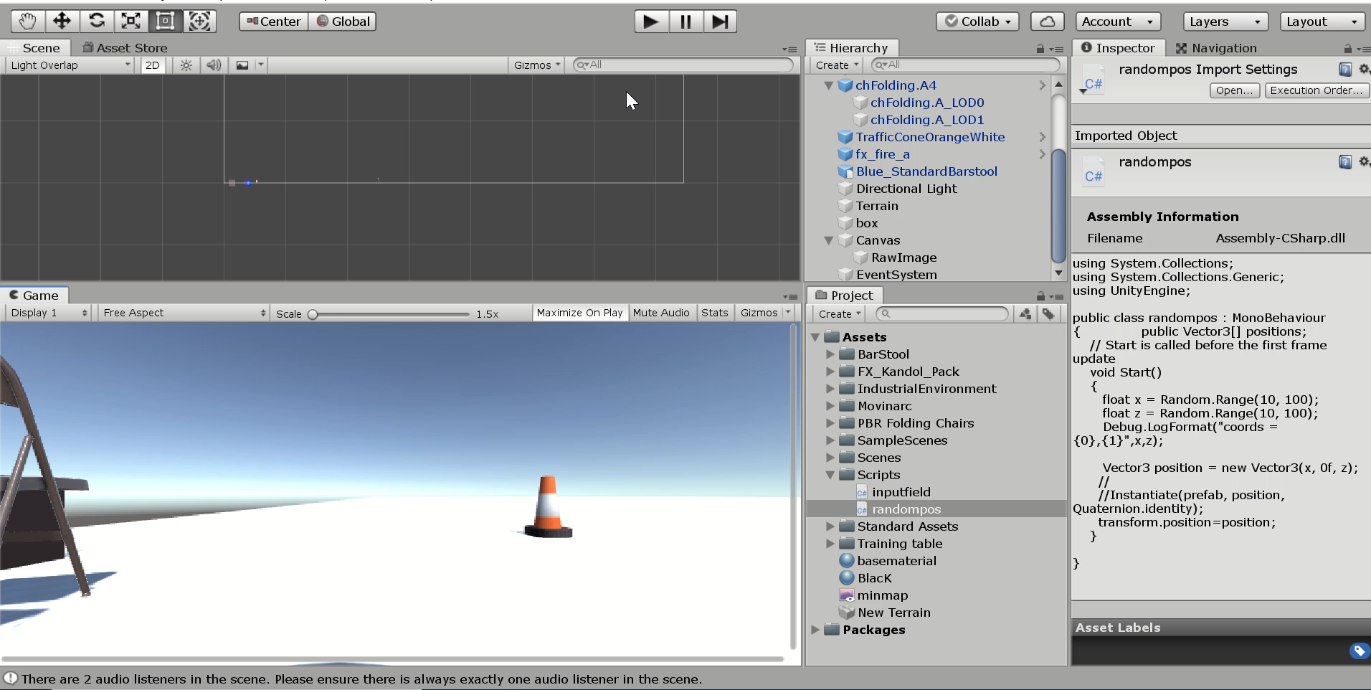

Slide 11
References
[1] Daniel Paul Barrett, Member, IEEE, Scott Alan Bronikowski, Member, IEEE, Haonan Yu, Member, IEEE, and Jeﬀrey Mark Siskind, Senior Member, IEEE, Driving Under the Inﬂuence of Language IEEE Transactions on Neural Networks and Learning Systems, VOL 29 NO.7 JULY 2018
[2] Cynthia A. Thompson, Raymond J. Mooney, Acquiring Word-Meaning Mappings for Natural Language Interfaces Journal of Artificial Intelligence Research 18 (2003), Jan 2003.
[3] Yang Zheng, Yongkang Liu, and John H.L. Hansen, Fellow, IEEE Navigation Orientated Natural Spoken Language Understanding for Intelligent Vehicle Device 2017 IEEE Intelligent Vehicles Symposium (IV) , June 11,2017.
[4] Thomas Kollar1, Stefanie Tellex1, Matthew R. Walter, Albert Huang, Abraham Bachrach, Sachi Hemachandra, Emma Brunskill, Ashis Banerjee, Deb Roy, Seth Teller, Nicholas Roy Generalized Grounding Graphs: A Probabilistic Framework for Understanding Grounded Commands December 2017.

Slide 12
References (Contd.)
[5] Simon Dobnik and Stephen Pulman, Paul Newman and Alastair Harrison Teaching a robot spatial expressions, Oxford University, Oxford
[6] Jos Carlos Rangel, Miguel Cazorla, Ismael Garca-Varea, Cristina Romero Gonzalez, Jesus Martinez-Gomez, Automatic semantic maps generation from lexical annotations, Springer Science + Business Media, LLC, part of Springer Nature 2018 , December 2016.
[7] Maxwell Forbes, Rajesh P. N. Rao, Luke Zettlemoyer and Maya Cakmak.’ Robot Programming by Demonstration with Situated Spatial Language Understanding 2015 IEEE International Conference on Robotics and Automation (ICRA) Washington State Convention Center Seattle, Washington, May 26-30, 2015 .
[8] Joseph Carsten, Dave Ferguson, and Anthony Stentz,’3D Field D*: Improved Path Planning and Re-planning in Three Dimensions’ , Proceedings of the 2006 IEEE/RSJ International Conference on Intelligent Robots and Systems October 9 - 15, 2006, Beijing, China .

Slide 13
References (Contd.)
[9] Jae Sung Park, Dinesh Manocha, ‘Combining Computer Vision and Real Time Motion Planning for Human-Robot Interaction,’ arXiv preprint arXiv:1608.04837, 2016.
[10] Matt MacMahon, Brian Stankiewicz, Benjamin Kuipers, ‘Walk the Talk: Connecting Language, Knowledge, and Action in Route Instructions ’ Page(s): 1475-1482,2006
[11] Ian Lane Davis, Anthony Stentz, ‘Sensor Fusion For Autonomous Outdoor Navigation Using Neural Networks’, Proceeding of the 1995 IEEE, Page(s): 338-343
[12] Congwei Hu, Wu Chen, Yongqi Chen and Dajie Liu, ‘Adaptive Kalman Filtering for Vehicle Navigation’ Journal of Global Positioning Systems (2003) , 20 November 2003

Slide 14
References (Contd.)
[13] Rehj Cantrell and Matthias Scheutz and Paul Schermerhorn and Xuan Wu ‘Robust Spoken Instruction Understanding for HRI IEEE (2010) , Page(s): 275-282 2010
[14] Velappa Ganapathy ,Soh Chin Yun, Tee Wee Chien ,’Enhanced D* Lite Algorithm for Autonomous Mobile Robot ,International Journal of Applied Science and Technology, Vol. 1 No.1; March 2011
[15] Manfred Eppe, Sean Trott, Jerome Feldman, ‘Exploiting Deep Semantics and Compositionality of Natural Language for Human-Robot-Interaction’ ,2016 IEEE/RSJ International Conference on Intelligent Robots and Systems (IROS) , October 2016
[16] Siding Li, Xin Xu, Lei Zuo ,’Dynamic Path Planning of a Mobile Robot with Improved Q-Learning algorithm’ ,Proceeding of the 2015 IEEE International Conference on Information and Automation, August 2015

Slide 15
References (Contd.)
[17] Qiuming Zhu ,’Hidden Markov Model for Dynamic Obstacle Avoidance of Mobile Robot Navigation ,Proceeding of the 1991 IEEE Transaction on Robotics and Automation, VOL. 7, NO. 3, JUNE 1991

Slide 16
Thank You

